Slide 1
Helen Stewart Outreach Coordinator

Slide 2
Our Story
Through grassroot efforts, a small group of family members came together in 1981 to address the need for brain injury services here in Massachusetts. These efforts created the Brain Injury Association of Massachusetts
The Brain Injury Association of Massachusetts was incorporated in 1982 as one of the first statewide brain injury associations in the U.S.

Slide 3
Our Mission
To create a better future for individuals with brain injury and their families through advocacy, education, prevention, research, and support.

Slide 4
Our Vision
To create a pathway for those impacted by brain injury to receive the right information, the right services, and the right support at the right time

Slide 5
THE SCOPE of ACQUIRED BRAIN INJURY

Slide 6
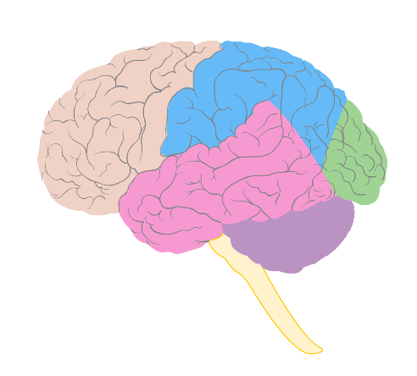
Understanding the Brain

Slide 7
FRONTAL
• attention
• motivation
• emotions
• judgment
• problem solving
• decision making
• speech
PARIETAL
• sense of touch
• sensations
• aroma
• reading
OCCIPITAL
• sight
• process images
TEMPORAL
• memory
• smell
• taste
• sound
BRAIN STEM
• sleep
• heart rate
• breathing
CEREBELLUM
• balance
• coordination

Slide 9
What is an Acquired Brain Injury?
An insult to the brain that has occurred after birth and is not hereditary or congenital.

Slide 10
Acquired Brain Injury
Non-Traumatic Brain Injury
Traumatic Brain Injury (TBI)
Caused by an INTERNAL event
Infections
Brain Tumors
Lack of Blood Flow or Oxygen
Caused by an EXTERNAL event
Brain damage caused by a blow to the head i.e. car crash, falls, assaults, gun shot wound, etc.

Slide 11
What can cause a Brain Injury?

Slide 12
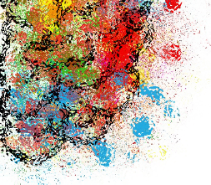
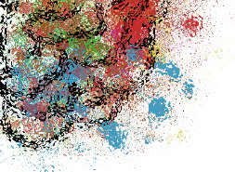
Infections
Anoxia
Shaken Baby Syndrome
Meningitis
Car Crash
Alcohol
Combat & War
Seizures
Underage Drinking
Construction Accidents
Aneurysm
Heart Attack
Passenger Ejection
Fighting
Suffocation
Assault and Battery
Stroke
Contact Sports
Drowning
Falling
Brain Cancer
Whiplash
Sports Accident
Illicit Drug Use
Slipping on Ice
Inhalants
Hematoma
Bike and Motorcycle Crash

Slide 13
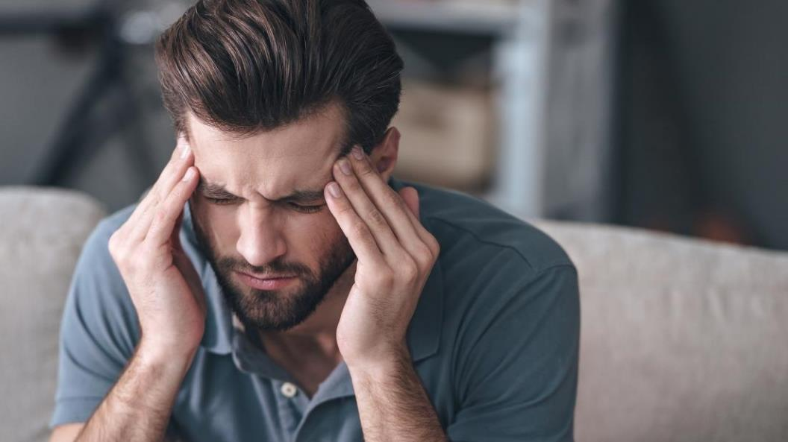
Effects of Brain Injury

Slide 14
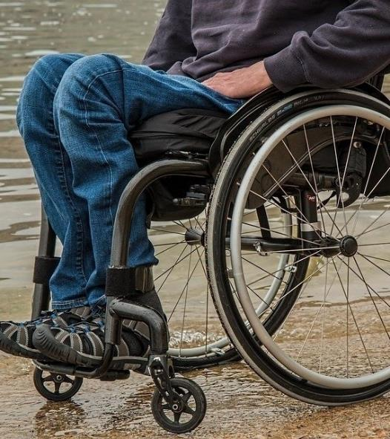
Physical Effects
Lack of energy
Difficulty with coordination, balance, and movement
Chronic pain, headaches, and dizziness
Visual and auditory changes
Seizures
Fine motor coordination problems
Paralysis/spasticity

Slide 15
Social and Emotional Effects
Personality changes
Excessive crying
Uncontrollable laughter
Decreased awareness of social rules
Depression
Lack of self control

Slide 16
Cognitive Effects
Poor memory
Difficulty learning
Difficulty concentrating
Difficulty problem solving
Slower processing speed
Poor judgment

Slide 17
What might you encounter as a First Responder?
Poor coordination, balance, or muscle control
Blurred speech, vision, or impaired hearing
Difficulty with attention, concentration, memory, or understanding
Difficulty controlling anger and/or aggressive behavior
Confusion, disorientation, dizziness
Difficulty processing and slow response time
Impatience, anxiety, or agitation
Seizures, headaches, or fatigue

Slide 20
For Your Toolbox
Stay calm if behavior escalates. Emphasize that you are here to help. Don’t rush, speak over, or become frustrated.
Suggest a few deep breaths rather than telling the person to “calm down”.
Use active listening strategies.
Redirect or refocus as needed.
Use short breaks to reduce both physical and cognitive fatigue and maximize attention.
Have only one person speaking at a time. Speak slowly and enunciate words.
Use one-step questions or instructions.
Notes:
Use phrases like “it sounds like” or What I’m hearing is” instead of “I understand”.

Slide 21
The Brain Injury Association of Massachusetts
Your Community Resource

Slide 22
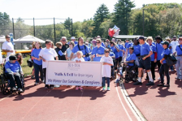
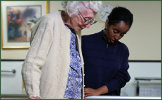
Public Policy
Prevention
Support
Education

Slide 23
DEDICATED TO CHANGE
In the last four decades BIA-MA
has played an instrumental role in:
Advocating for funding for individuals with brain injury at a State level
Helping shape services on a national level

Slide 24
PUBLIC POLICY
Establishment of the Statewide Head Injury Program (SHIP), within the Massachusetts Rehabilitation Commission, in 1985
Establishment of the trust fund (Head Injury Treatment Services: HITS) *Funds state services for people with traumatic brain injury
Instrumental in passage of the seatbelt law (1986), then passing the secondary Seat Belt Law (1993)
Hutchinson v. Patrick (Federal Class Action Lawsuit on behalf of individuals with acquired brain injury, 2008)
Notes:
Individuals cited for particular roadway infractions, infractions that put people at risk for brain trauma are fined for those violations, and these collected fines go to the HITS fund.

Slide 25
PUBLIC POLICY
Recent/Current Initiatives include:
In the last three legislative sessions, an additional $4,930,157 increase for SHIP
In January 2021, the Omnibus Health Care Bill passed requiring commercial health insurance plans, the Group Insurance Commission (GIC) and Mass Health to cover cognitive rehabilitation for COVID-19 patients
Cognitive Rehabilitation Bill (S629/H1078) will require commercial health insurance plans to cover cognitive rehabilitation after ABI

Slide 26
PUBLIC POLICY
Recent/Current Initiatives include:
Head Injury Treatment Services Trust Fund Bill (S941/H164) will increase funding by increasing fines under the trust fund
Acquired Brain Injury Advisory Board Bill (S83/H1078) will establish a permanent legislative advisory board on ABI and will continue the work of 2019 ABI Commission

Slide 27
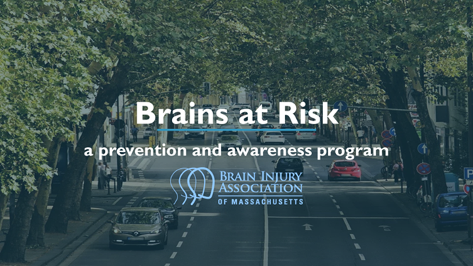
PREVENTION
BIA-MA offers several programs that educate the community on brain injury prevention.
Notes:
Think A-Head- is a dynamic school-based program that has been teaching students to avoid risk-taking behavior and develop healthy living habits. BIA-MA has visited hundreds of Massachusetts schools and educated thousands of students!!
Brains At Risk- is an awareness and prevention program that links dangerous and risky driving behaviors to the devastating effects of traumatic brain injury (TBI).
Survivors Voice- is similar to Brains At Risk but is specifically tailored to speak to those who are substance use treatment, and second offender DUI/OUI programs. All of these programs get to hear the personal stories of those whose lives have been permanently affected by brain injury that was caused by impaired or risky driving behaviors.

Slide 28
EDUCATION
Annual Brain Injury Conference
Acquired Brain Injury Clinical Continuing Education Series
Family and Survivor Education
Introductory Acquired Brain Injury Series
Notes:
Education/training for individuals, families, and professionals to foster understanding of the long-term impact of the injury
Review descriptions of each; and we will talk more on this at the end.

Slide 29
SUPPORT & RESOURCES
Promote the general welfare, rights and dignity of persons with brain injury
Promote and foster the empowerment of persons with brain injury
Assist survivors and families to obtain appropriate services and support
Provide information and resources for persons with brain injury, their families, friends, and professionals

Slide 30
NeuroResource Facilitation
The NeuroResource Facilitator (NRF) will work directly with individuals, families, and caregivers who have been affected by traumatic brain injury, stroke, brain tumors, and other forms of acquired brain injury. The NRF will navigate alongside the individual, family, or caregiver to provide resource support, assess needs, and collaborate with community members/service providers for the purpose of providing one-on-one navigation support.

Slide 31
Support Groups
Brain injury can have a traumatic effect on both survivors and their families. BIA-MA sponsors support groups that provide survivors and their loved ones a forum for sharing information, a compassionate and understanding peer group, and an opportunity to socialize and make new friends with others..
Notes:
Add in support groups are virtual until further notice but have been highly recommended and attended during the pandemic.
Put Support Group in the chat-explain the calendar can be found on that website, not sure which group is for you? Contact us @ info@biama.org

Slide 32
New BIA-MA Website!
Basic brain injury information
Survivor & Caregiver educational events/activities/support groups
Resource & Support information request
Professional educational opportunities
Community based prevention programs
Advocacy/Public Policy opportunities

Slide 33
Check us out!
www.biama.org

Slide 34
Brain Injury Screening
Notes:
S

Slide 35
What can Brain Injury screening provide?
Determines lifetime exposure to brain injury
Identifies associated challenges that may be present for youth and adults
It does NOT diagnose brain injury

Slide 36
Benefits of Screening
Alert you to possible cognitive impairments
Proactive vs. Reactive response
Increase the odds of successful interactions
This Photo by Unknown Author is licensed under CC BY-NC-ND

Slide 37
Introducing a Screening Tool
Keep it conversational
Address any known risk factors or recent events
Include it with other screening conversations
This Photo by Unknown Author is licensed under CC BY

Slide 38
OBISSS TOOL
Online Brain Injury Screening and Support System
Validated screening tool for ages 10+
HIPPA compliant
Follow up includes MA resources for BI
Systems Questionnaire for Brain Injury (SQBI)

Slide 39
TRY IT!
Use TEST as first and last name.
State: MA
Password: 857
OBISSS Link:
nashia.org/obisss

Slide 40
OBISSS Resources
Symptom Questionnaire for Brain Injury
Tip Sheets
MRC Connect and Brain Injury Program Information
Brain Injury Association of Massachusetts (BIA-MA) Information

Slide 41
Data Collection
Provides state data of brain injury in screening settings
Contributes to the larger picture of national lifetime history of brain injury
Leverages data collected to help inform program and policy in your setting

Slide 42
How do I start?
Have a conversation about why you are suggesting completing a brain injury screening and how you think it might be beneficial
Share the link, log-in information and your email address with the individual who is completing the screening
Review the emailed results with this individual
Decide together how to best use this information

Slide 43
Our purpose is to provide support to brain injury survivors and their families, offer programs to prevent brain injuries, educate the public on the impact of brain injury, and advocate for community services.
For more information:
www.biama.org 800-242-0030

Slide 44
Intellectual Property Statement
The content of this presentation represents the intellectual property of the Brain Injury Association of Massachusetts. Unless specifically noted, this presentation and handouts should not be replicated, recorded, or distributed without the written authorization of the Brain Injury Association of Massachusetts.

